Slide 1

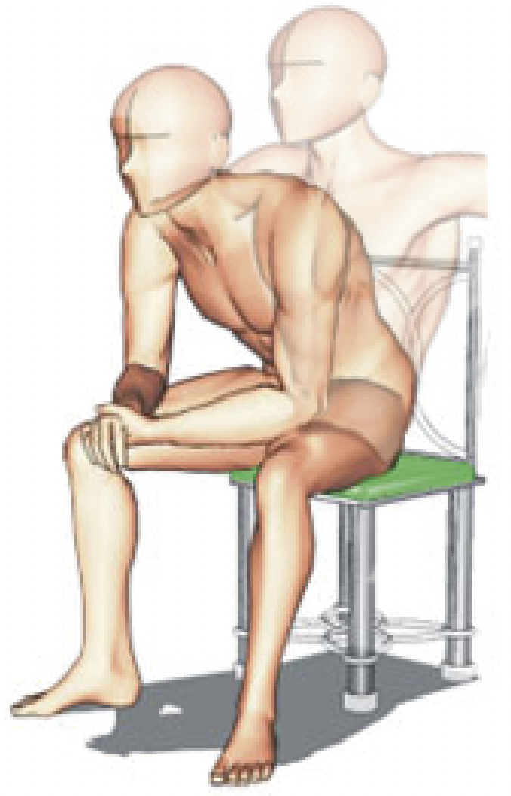
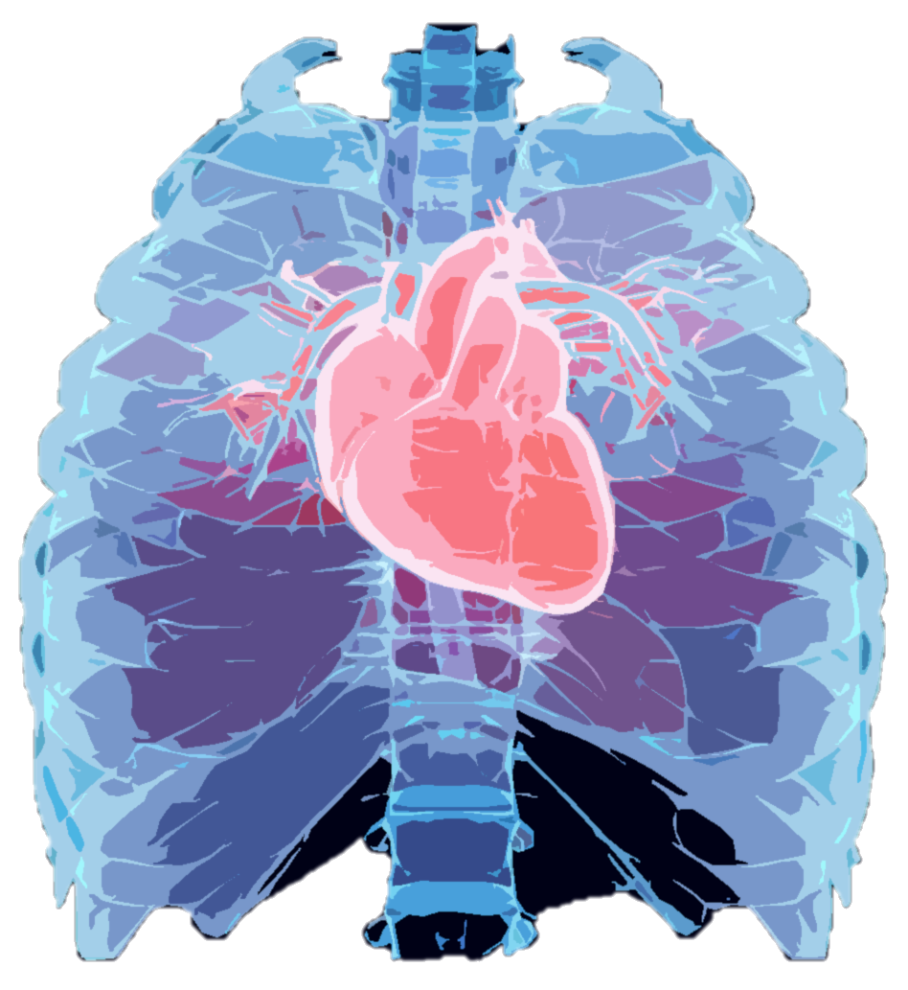
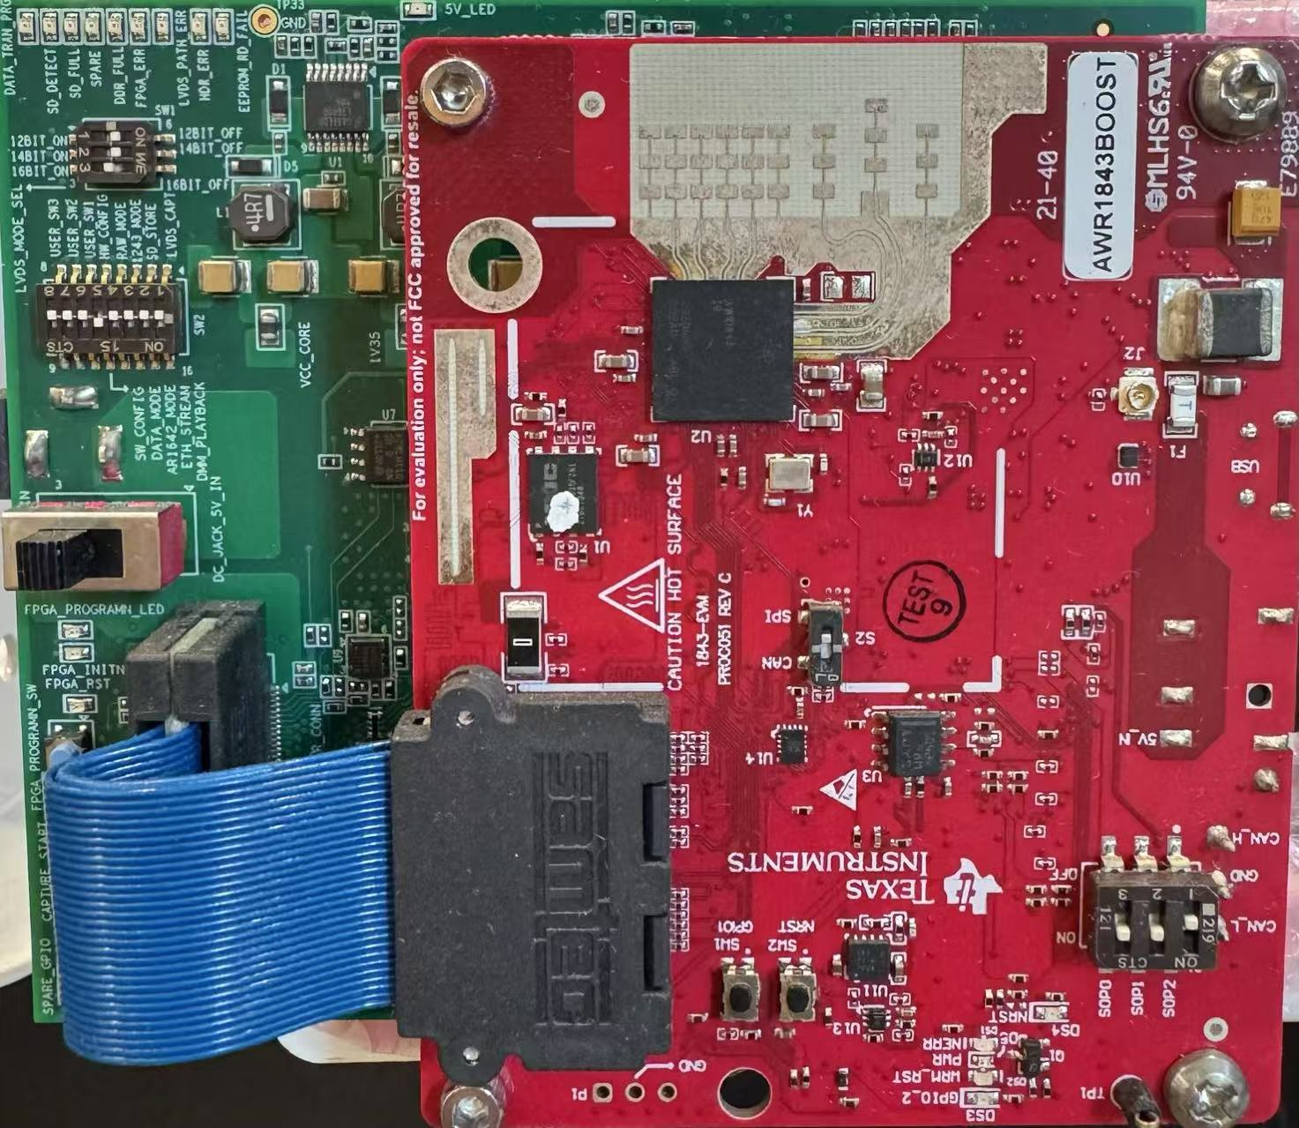
(b) Cardio-Focusing and -Tracking (CFT) Algorithm
ECG Monitor
Low-SNR Signals
0.4m
Derivative-Free
Optimization
0.2m
0.4m
TI-AWR 1843
77-81GHz with Tx2Rx4
Subject with Random Body Position
Search Space
Search for Cardio-Focused (CF) point
High-SNR Signals
Format Radar Signal to
the Data Matrix
Provide Initial State
for CFT
Convert to Spectrogram
(a) Rough Localization
(c) Transfer Learning
Pre-text Task Training
Backbone
Task
Head
t
FFT
Sparse Signal Recovery
Chirps (Fast Time)
Knowledge
Transfer
Ch. 8
…
Backbone
Task
Head
Ch. 2
Virtual Antenna Channels (AoA)
Ch. 1
Spectrograms
ECG Outputs
Frames (Slow Time)
Object Detection
Fine-tuning
Notes:
Already graduated and will get the degree in November

